Slide 1
Up to the Challenge;
Libraries Successfully Serving Job Seekers
Presented by
Rebecca Mazin
May 13, 2011
Notes:
Welcome group. Intro background;
ILR, NLRB, Owens-Corning, Hyatt, Macklowe/Millennium, Consulting, HR Answer Book, consultant construction company work, sites, Rome, Georgia, Va, etc.
This is a working session – you should have the evaluation forms handy and will have a chance to get writing done.
This is a topic that induces sweaty palms on both sides
Today we will decrease negativity and maximize the process.

Slide 2
The Job Market
Job openings are growing.
There are still more candidates than jobs.
Employers prefer to hire people who are working.

Slide 3

Job Seeker Mindset

Slide 4
Finding a Job is a Job
The Candidate Must do the Work!

Slide 5
Job Seeker Musts
A professional email address.
A plan.
Notebook and calendar.

Slide 6
A Professional Email Address
Which one works?
dazednconfused@aol.com
number1yankeefan@yahoo.com
catlover23@hotmail.com
rebeccamazin@gmail.com

Slide 7
Common Job Seeker Questions
Resume help.
Online application assistance.
Reference materials and search sources.

Slide 8


Slide 9
Recommend One or Two
Resume Formats

Slide 10
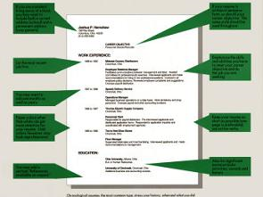
Chronological Resumes

Slide 11
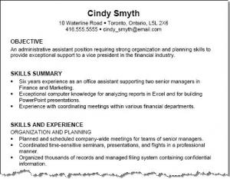
Functional Resumes

Slide 12
Resume Must Do List
Edit, edit and edit again.
Proof read, proof read and proof read some more.
Be prepared with more than one resume.

Slide 13
More Resume Musts
Include quantifiable results.
Match keywords to type of job and/or opening.

Slide 14
Make the Hiring Manager’s Life Easier
Clearly label a resume with name and date.
Follow directions for submission.
One page whenever possible.

Slide 15
Resume Dont’s
Jargon and job specific abbreviations.
Repetition and inconsistencies.
References furnished upon request.
Fancy formats.

Slide 16
Online Job Applications

Slide 17
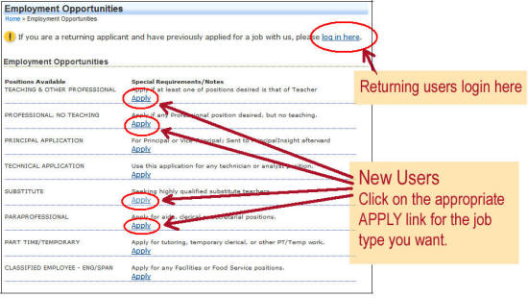

Slide 18
Online Applications
User should have information handy.
Typically take a minimum of 45 minutes.
Can include math tests, customer service and honesty questions.

Slide 19
Online Applications
Follow up with phone call.
Follow up in person.

Slide 20
Finding Job Openings Online
The big boards.
Go local.
Niche sites.
Company web sites.

Slide 21

Jumbo Job Sites

Slide 22
Go Local
Add regional keywords.
Newspapers.
Patch and other neighborhood online news sites.
www.Craigslist .org

Slide 23
Craigslist Tips
Identify the company.
Cut and paste email adress.
Keep track of progress.
If it looks too good to be true, it probably is.

Slide 24
Finding the Right Niche Site
By industry.
Job type.
Professional organizations.
College alumni.

Slide 25
Company Web Sites
Look for available jobs.
What do articles, blogs say about working for the company?
Check Twitter and Facebook links.
Notes:
The Kroll furniture example.

Slide 26
Find Employer Facebook Fan Pages
Sears
Whole Foods Markets
Notes:
Is this acceptable to the employee?
It may be.
How does this affect the ability to get future work? (for trades)
Can the person learn more to perform at a higher level?

Slide 27
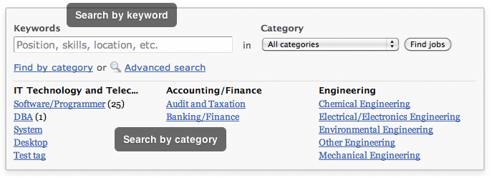
Keywords

Slide 28

MatchKeywords

Slide 29

Customize Cover Letters

Slide 30
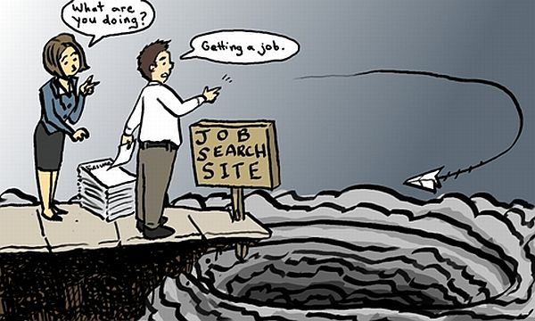
Where do all the applications go?

Slide 31
How Are Most Employees Hired?
Referrals

Slide 32

Networking Basics

Slide 33

Online

Slide 34
What’s new? What’s different?
18 million plus US Twitter users
55 million LinkedIn profiles to browse
More than 103 million US Facebook users
Hundreds of millions of YouTube videos
Notes:
Create Ground Rules Flip Chart and Post- lots of potential confidential information, working in pairs you will have options
We have a lot of material to cover in a ½ day.
When we practice you will have a chance to talk through some scenarios that should be helpful.

Slide 35
Social Media and the Job Search
Keeping up with industry social networks
Participating in LinkedIn
Subscribing to Blogs and RSS feeds
Getting on Twitter
Checking vacation and party photos on Facebook
Notes:
Page 1 of handout. Talk through exercises
Break room into groups.
Identify challenges on a flip chart paper.
Post and review.

Slide 36
Search Your Own Name
Google
Bing
Clubs and Affiliations
Linked In

Slide 37
Have you Googled yourself?
Notes:
You have talked about good evaluations, bad evaluation situations and your individual challenges.
But why should we do evaluations.
The #1 reason is to provide employees with feedback, but this should never be the first time employees get this feedback, both positive and negative. Page 4 of your handouts has a list of other activities to monitor performance and enhance employee self esteem.
Effective performance appraisals enhance employee development because they give employees a roadmap or guideline for performance.
They increase productivity because employees know what is expected of them.
This is the one time of the year you can sit down and have a conversation that is all about an employee a key step for trusting respectful relationships but not the first time for items, more of a big picture.
They safeguard Kirchhoff from legal liability when they are done well there is something in writing to support employment decisions. When done poorly that could land the company in hot water if they are careless or poorly prepared.

Slide 38
Search Your Name

Slide 39
Images on the Web
Photos
Video
Personal affiliations
Notes:
Evaluations can be used to support a number of different types of claims or litigation against an employers. These are the most common.
Title VII of the Civil Rights act of 1964 banned employment discrimination based on protected classes, New York extends the list of protected classes.
denying employment to a person because of marriage to, or association with, an individual of a particular race, religion, national origin, or an individual with a disability. Title VII also prohibits discrimination because of participation in schools or places of worship associated with a particular racial, ethnic, or religious group.
New York State also protects employees from discrimination based on sexual orientation, military status and marital status
ADA disability.
One negative evaluation would be unlikely to create a claim but the eval or language in the eval could support a claim. An eval that was positive can be a conflict with a subsequent decision., eg Anuka Brown Saunders.
Retaliation in virtually every labor law, Workers’ Comp, Employment Discrim.,
Wage and Hour, Whistle blowing so employees engage in any kind of protected activity should not dissuade a reasonable person from filing a claim.

Slide 40


Photos
Notes:
You are responsible for getting these done and conducting the discussion with the employee.
They are due to HR by____________

Slide 41
Video
Is the content?
Related in any way to potential work, positive or negative.
Reflective of skills and qualities needed for the job.
Include identifiable political or social viewpoints.
Notes:
This outline is on page 2 of your handouts.
When you look at the documentation before you start writing it makes it easier to create a coherent document and have examples that support your observations about employee performance.
Personal observation has to be specific, avoid snapshot management.
Ongoing documentation is any notes or items that you keep.
A personnel file should be checked for both positive and negative items, Who did the previous evaluations and what did they look like?
Observations of other people, again must be specific, not jus, “Oh yeah, Bill is a good guy.”

Slide 42
Who uses social media for hiring?
More than 23% of employers
Notes:
If ask for a summary here is a recommended way to do it.
What are you proudest of or top 3-5 results and the contrary. This is different that strengths and weaknesses this is asking for specifics for both the good and the not so good.
Notice the way I wrote the “could have gone better” section asks what the individual could do to avoid a summary that just blames poor results on others, or job changes.
They can’t just pick, “The job was cancelled.”

Slide 43
What should a Job Seekers LinkedIn Profile Look Like?
Include a photo.
Reflect resume content.
Contain recommendations.
Update with new information.

Slide 44
LinkedIn Job Search Basics
Join Groups
Create Updates
Send Messages
Search by Company
Notes:
So you have done your research, you have great examples not it’s time to take out the form!
Understanding how to apply the rating scale is a key.
Has anyone ever worked for someone who said no one is a 5?
Does anyone here think no one is a 5?
Why have the rating if it won’t be used.
Turn to page 3 of your handouts. Review ratings.
Pick an employee to rate take out your form. Rate at least 3 items and discuss and explain your ratings in pairs.
Tailor for group.
Debrief about applying ratings.

Slide 45
Join LinkedIn Groups
Professional
Alumni, School & Work
Geographical
Special Interests

Slide 46
Send LinkedIn Messages Announcing Search
To specified contacts.
To all of your contacts.
To groups.
Notes:
Page 9 of handouts
You have done all your prep work, now it is time to conduct the evaluation discussion.
Has anybody ever had a “here’s the form, sign this,” evaluation?
Or the manager starts out by saying, now where is that form?
You don’t want an employee walking past to first her, come on in sit down, let’s do your evaluation.
Don’t rush or allow for interruptions. As we said before, this is your golden opportunity to spend time focusing on the employee, one-on-one.
If there is bad news don’t bury it or gloss over it, and with good news let the person enjoy it.

Slide 47
Networking In Person
Alumni Groups.
Business and Professional Group.s
Social, local and religious.

Slide 48
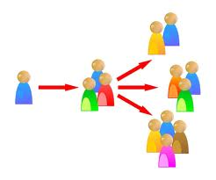
Networking
Cultivating one-on-one connections.
Networking meetings.

Slide 49


Slide 50
Everything Will Change
Very Quickly!

Slide 51
What questions do you have?

Slide 52
Thank you for your participation.
rebeccamazin@recruitright.net
914-834-0870
@thehranswer

